Slide 1
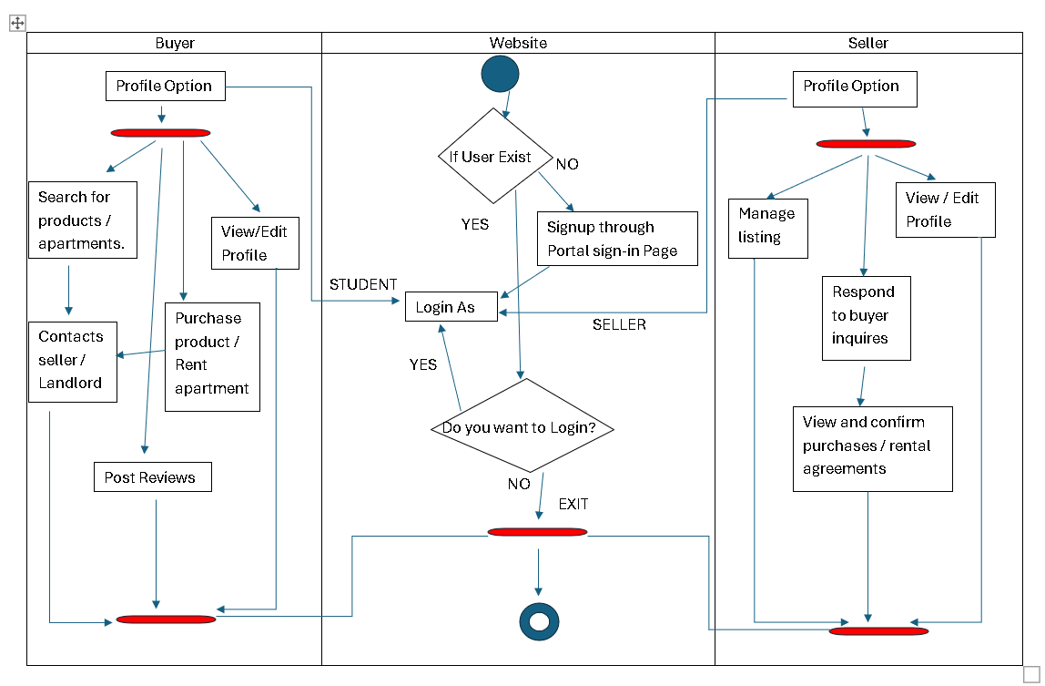
Bargain Hunter
Activity Diagram

